Slide 1
NLP Study – 2주차
<Paper Review>
Sequence to Sequence Learning
with Neural Networks
발표자: 최희정
I Sutskever. Sequence to Sequence Learning with Neural Networks. In NIPS, 2014.

Slide 2
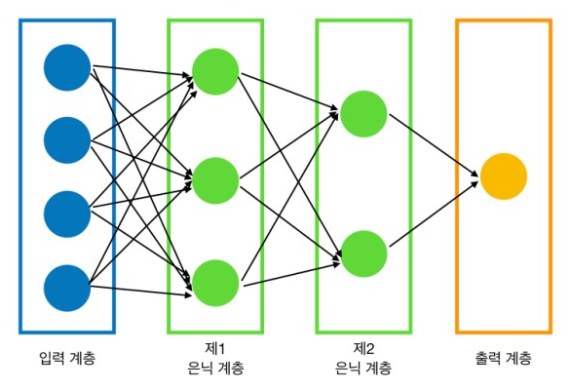
Why doesn’t DNN fit Sequence?
NLP Study – 2주차
DNN(Deep Neural Network)
→ Hidden Layer가 2개 이상 포함된 Neural Network
Fixed Dimensionality
DNN Structure – 김성진, 코딩셰프의 3분 딥러닝, 케라스맛, 한빛미디어
발표자: 최희정
I Sutskever. Sequence to Sequence Learning with Neural Networks. In NIPS, 2014.

Slide 3
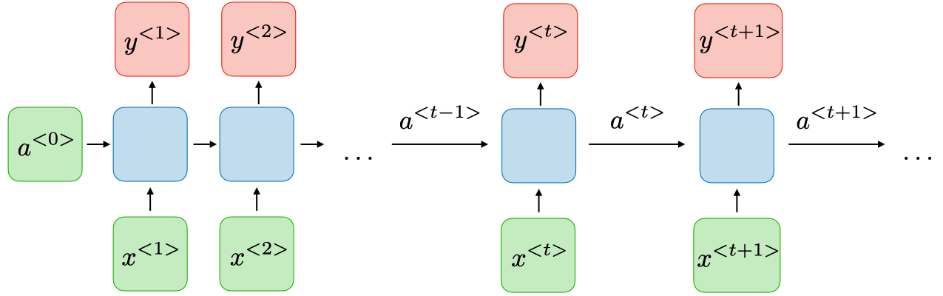
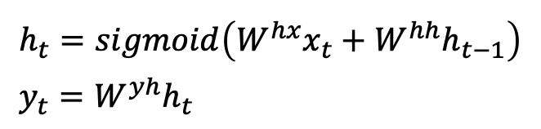
RNN’s Structure
NLP Study – 2주차
Feed Forward Neural Network (FFNL): hidden layer를 통과한 값은 output layer로만 들어감
Recurrent Neural Network (RNN): hidden layer를 통과한 값은 hidden layer와 output layer로 들어감
$$h_{t}=sigmoid\left(W^{hx}x_{t}+W^{hh}h_{t−1}\right) \\ y_{t}=W^{yh}h_{t}$$
https://stanford.edu/~shervine/l/ko/teaching/cs-230/cheatsheet-recurrent-neural-networks
발표자: 최희정
I Sutskever. Sequence to Sequence Learning with Neural Networks. In NIPS, 2014.

Slide 4

RNN’s Problem, and LSTM
NLP Study – 2주차
Long Term Dependency
Vanishing Gradient or Exploding Gradient
→ Sequence의 길이가 길어질수록 성능 저하
LSTM이 이러한 문제점을 해결함
발표자: 최희정
I Sutskever. Sequence to Sequence Learning with Neural Networks. In NIPS, 2014.

Slide 5
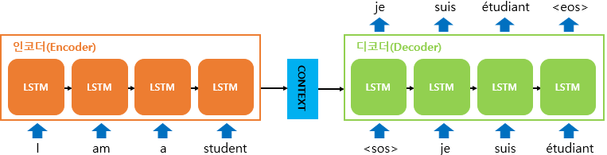
Proposed Model
NLP Study – 2주차
LSTM을 활용한 모델 구조
Encoder: input sentence를 context vector로 만듦
Decoder: encoder가 만든 context vector를 target sequence로 만듦
https://wikidocs.net/24996
발표자: 최희정
I Sutskever. Sequence to Sequence Learning with Neural Networks. In NIPS, 2014.

Slide 6
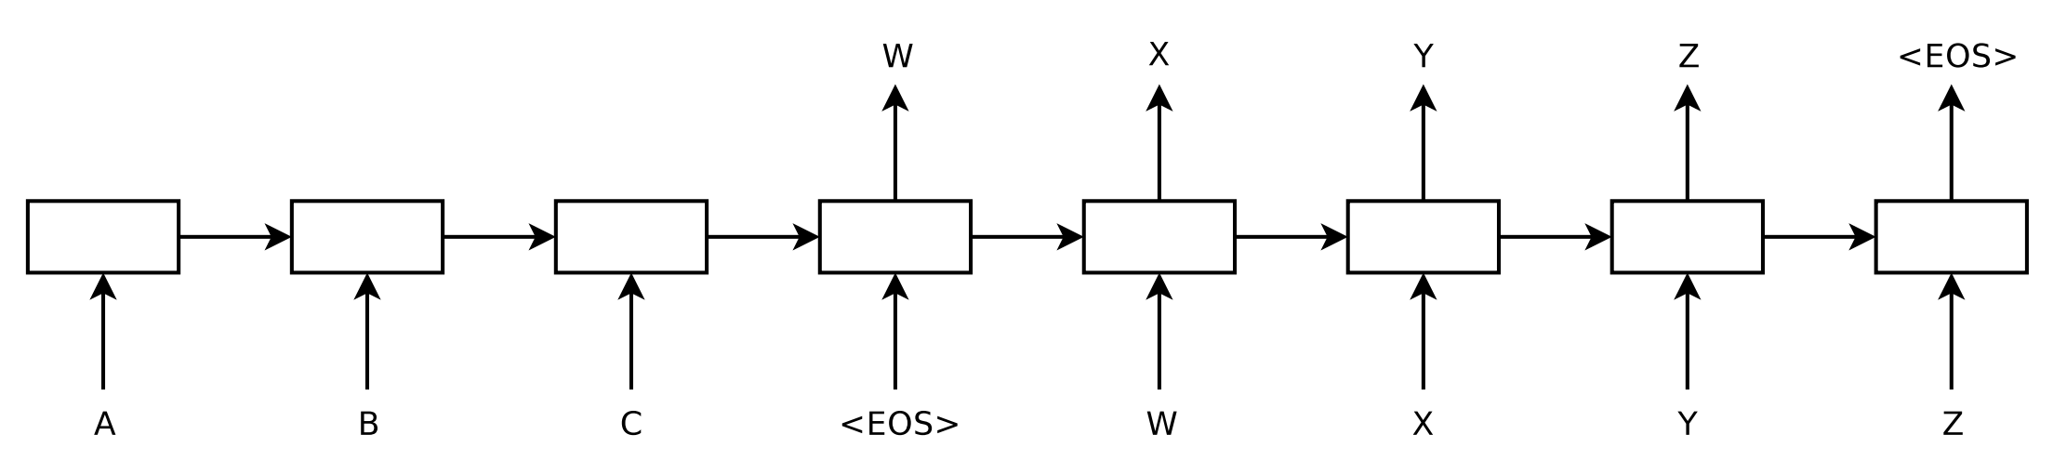
Proposed Model
NLP Study – 2주차
Figure 1. input 시퀀스 “ABC”를 읽고, output 시퀀스 “WXYZ”를 만들어낸다.
end-of-sentence token(<EOS>)를 출력한 다음에 예측을 멈춘다.
LSTM은 input 시퀀스를 역으로 읽음에 주의해야 한다.
→이렇게 해서 데이터의 최적화 문제를 훨씬 쉽게 만드는, 많은 short term dependency를 만들어낸다.
발표자: 최희정
I Sutskever. Sequence to Sequence Learning with Neural Networks. In NIPS, 2014.

Slide 7
Proposed Model
NLP Study – 2주차
Fixed Length
Variable Length
https://wikidocs.net/24996
발표자: 최희정
I Sutskever. Sequence to Sequence Learning with Neural Networks. In NIPS, 2014.

Slide 8
Proposed Model
NLP Study – 2주차
Contribution
“First, we used two different LSTMs: one for the input sequence and another for the output sequence”
모델의 파라미터 수가 증가하므로 더 많은 양의 학습 가능
“Second, we found that deep LSTMs significantly outperformed shallow LSTMs, so we chose an LSTM with four layers.”
“Third, we found it extremely valuable to reverse the order of the words of the input sentence.”
발표자: 최희정
I Sutskever. Sequence to Sequence Learning with Neural Networks. In NIPS, 2014.

Slide 9
Proposed Model
NLP Study – 2주차
“Third, we found it extremely valuable to reverse the order of the words of the input sentence.”
A B C D → W X Y Z
D C B A → W X Y Z
A와 W 사이의 거리는 가까워졌지만, 단어 쌍 사이의 거리 평균은 동일하다.
Why?
발표자: 최희정
I Sutskever. Sequence to Sequence Learning with Neural Networks. In NIPS, 2014.

Slide 10



Proposed Model
NLP Study – 2주차
앞에 나온 데이터가 더 중요하다.
Source sentence의 앞쪽 데이터를 뒤쪽으로 옮겨주면 (reverse)
Source sentence의 중요한 데이터와 target word 사이의 거리가 가까워진다.
$x^{<1>}$ 의 영향을 받는 데이터들:
$$x^{<2>}, x^{<3>}, x^{<4>}, …, x^{<n>}$$
$x^{<n−2>}$ 의 영향을 받는 데이터들:
$$x^{<n−1>}, x^{<n>}$$
https://stanford.edu/~shervine/l/ko/teaching/cs-230/cheatsheet-recurrent-neural-networks
발표자: 최희정
I Sutskever. Sequence to Sequence Learning with Neural Networks. In NIPS, 2014.

Slide 11
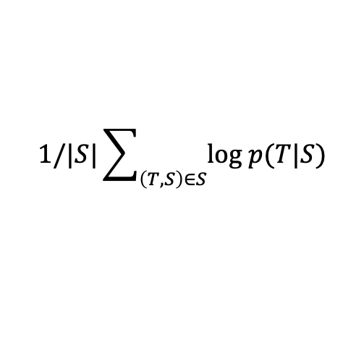
Decoding and Rescoring
NLP Study – 2주차
주어진 source sentence S에 대해, 맞는 번역 T의 log probability를 최대화
$$1/|S|\sum_{\left(T, S\right)∈S}{\text{log} p(T|S)}$$
일단 학습이 한 번 끝나면, LSTM에 따라 가장 확률이 높은 translation을 찾는다.
발표자: 최희정
I Sutskever. Sequence to Sequence Learning with Neural Networks. In NIPS, 2014.

Slide 12
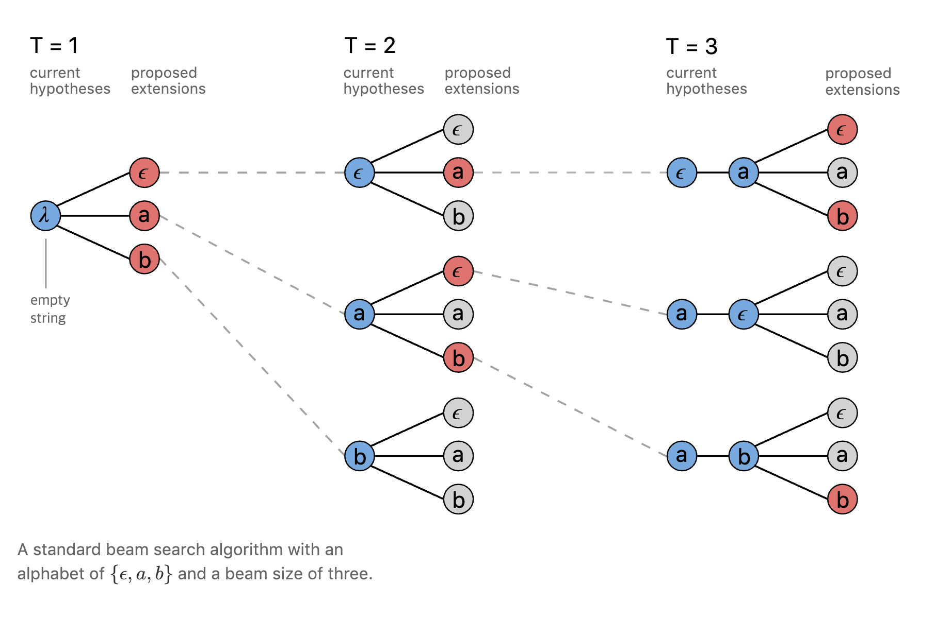
Decoding and Rescoring
NLP Study – 2주차
Left-to-Right Beam Search Decoder
Beam size에서 가장 큰 확률을 계속해서 찾아나간다.
https://ratsgo.github.io/speechbook/docs/neuralam/ctc
발표자: 최희정
I Sutskever. Sequence to Sequence Learning with Neural Networks. In NIPS, 2014.

Slide 13
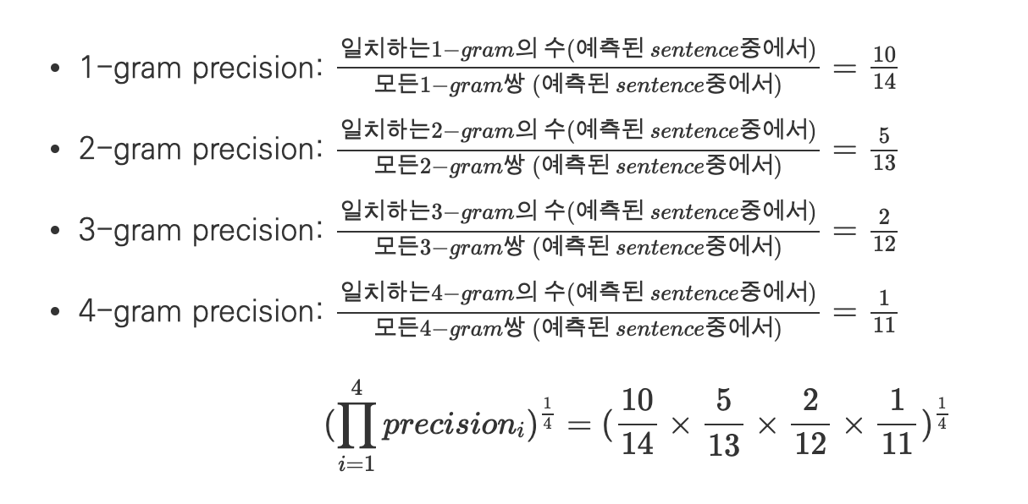
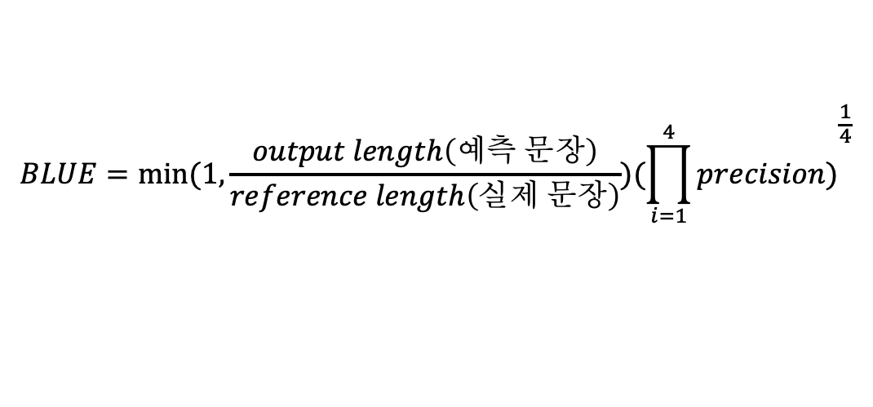
Experimental Results
NLP Study – 2주차
BLUE score(Bilingual Evaluation Understudy Score)
$$BLUE=min⁡(1, \frac{output length\left(예측 문장\right)}{reference length\left(실제 문장\right)}){(\prod_{i=1}^{4}{precision)}}^{\frac{1}{4}}$$
https://donghwa-kim.github.io/BLEU.html
발표자: 최희정
I Sutskever. Sequence to Sequence Learning with Neural Networks. In NIPS, 2014.

Slide 14
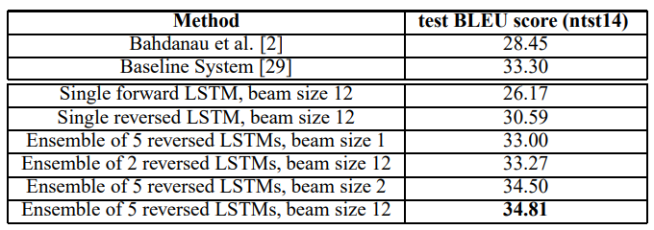
Experimental Results
NLP Study – 2주차
WMT’14 English to French test set (ntst14)
Beam size가 2인 5개의 LSTM의 앙상블이 beam size가 12인 1개의 LSTM보다 성능이 더 좋음에 주목하라.
발표자: 최희정
I Sutskever. Sequence to Sequence Learning with Neural Networks. In NIPS, 2014.

Slide 15
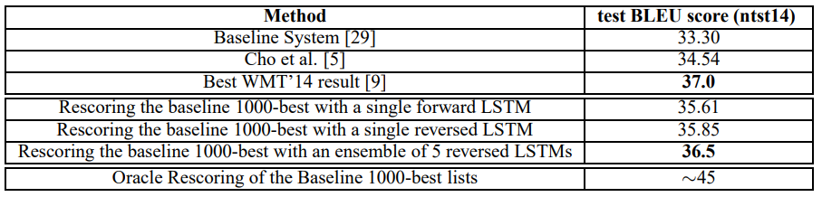
Experimental Results
NLP Study – 2주차
WMT’14 English to French test set (ntst14)
Statistical Machine Learning(SMT) system과 Neural Network를 함께 쓴 방법으로 BLUE score 측정
발표자: 최희정
I Sutskever. Sequence to Sequence Learning with Neural Networks. In NIPS, 2014.

Slide 16
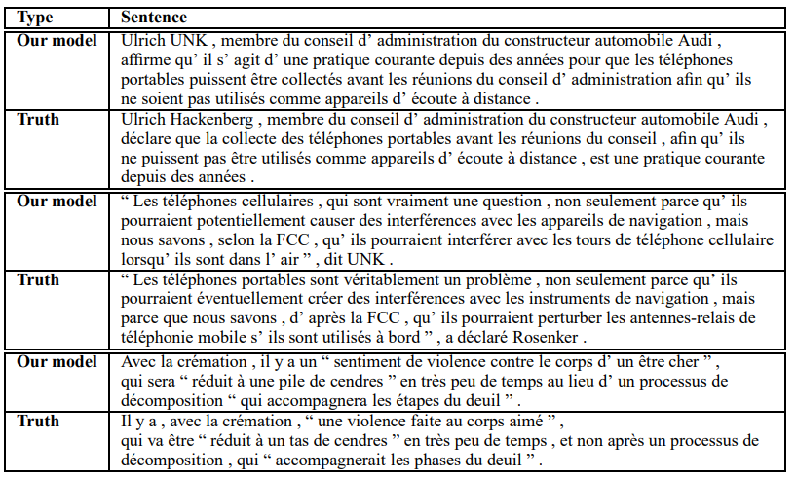
Experimental Results
NLP Study – 2주차
발표자: 최희정
I Sutskever. Sequence to Sequence Learning with Neural Networks. In NIPS, 2014.

